Slide 1
AAPT Governance Changes
Steve Iona, President
Beth Cunningham, Executive Officer

Slide 2
Background
AAPT formed in 1930
Incorporated in the state of New York in 1957 to be established as a nonprofit and have stronger legal position
Executive Office now in College Park, MD
New York legislation passed Nonprofit Revitalization Act of 2013 and became effective on July 1, 2014

Slide 3
Nonprofit Revitalization Act of 2013 – Main Issues
The Act requires:
  Whistle Blower Policy
  Conflict of Interest Policy
  Specific audit procedures and financial reporting requirements
  Board independence
  Disclosure of related party transactions

Slide 4
Nonprofit Revitalization Act of 2013 – Main Issues Continued
The Act allows nonprofits
  to use modern methods of communication including conducting videoconferencing of board meetings
  email to be the official form of communication with members
The result is modernization of nonprofit governance and following of best practices!

Slide 5
AAPT and the 2013 Act
Much of AAPT's governance is in compliance with parts of the new act.
However, there are some important changes that AAPT needs to make in order to be compliant with the new act as well as with previous New York nonprofit laws.
Notes:
We have been using advice of attorneys at Venable, LLC (law firm that specializes in nonprofits) – Sharon is located in the state of NY.

Slide 6
Issue 1: Quorum
No quorum for elections by members was in the AAPT Constitution or By Laws.
New York state law assumes quorum is a majority of all members eligible to vote (approx. 6,500)
Action Taken: Executive Board approved definition at November 2014 meeting – quorum is 100 voting members (in Bylaws)
Notes:
Currently, about 15% or around 1,500 vote in the General Election each fall. It would be very, very challenging to get over 3,000 votes!

Slide 7
Issue 2: Whistleblower Policy and Conflict of Interest Policy
AAPT had Whistleblower Policy and Conflict of Interest Policy but both weren’t compliant with new NY Act
Action Taken: Executive Board approved new Whistleblower Policy and COI Policy at November 2014 meeting
Notes:
COI policy will be included in EB HB; Whistleblower Policy in both EB HB and Employee HB

Slide 8
Issue 3: Audit Committee
The previous Audit Committee membership and charge did not conform to New York state law
  All members of Audit Committee must be members of the Executive Board
  Additional oversight responsibilities were added to the charge.
Action Taken: The Executive Board approved the new Audit Committee membership and charge at the November 2014 meeting.
Notes:
Audit Committee will have oversight of Whistleblower Policy and COI Policy

Slide 9
Issue 4: Allowing Electronic Voting to be Non-Unanimous
Since the Certificate of Incorporation does not state otherwise, AAPT elections or motions conducted electronically require unanimous votes
Proposed Action: Vote to approve amendment to Certificate of Incorporation to allow non-unanimous voting via electronic elections

Slide 10
Additional Changes to Certificate of Incorporation
Add post office address of office in Maryland (where AAPT’s books and records are kept)
Designate the Secretary of State (of NY) as agent to process information
These changes require affirmative approval by 100 members
An officer of AAPT will ensure necessary paperwork is filed in NY

Slide 11

For more information: aapt.org

Slide 12
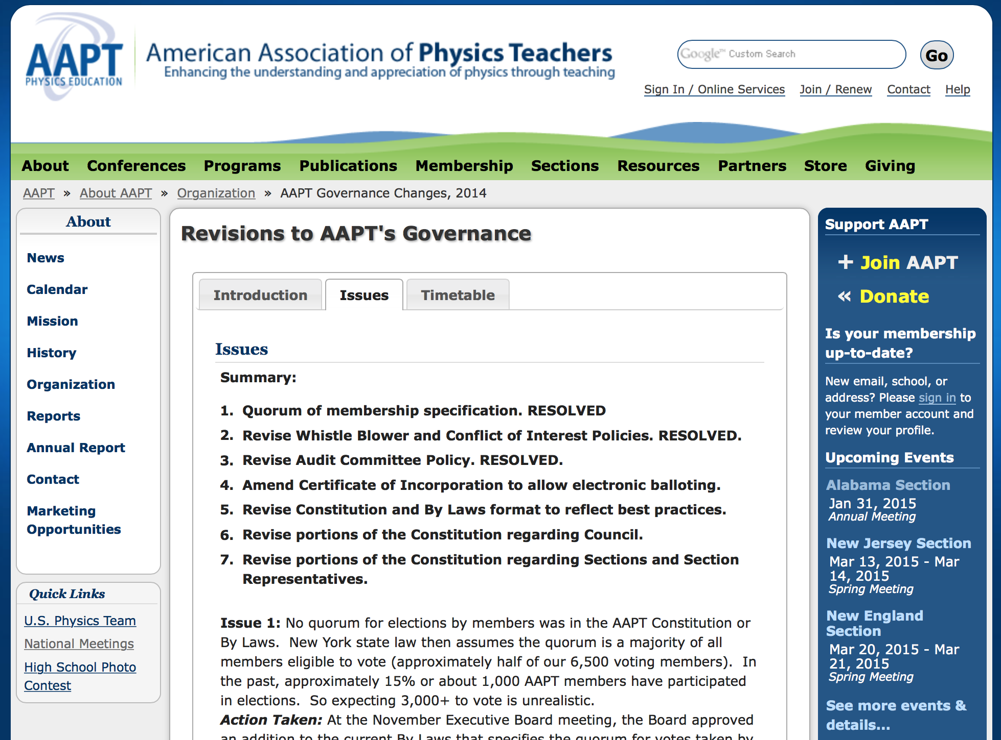
For more information

Slide 13
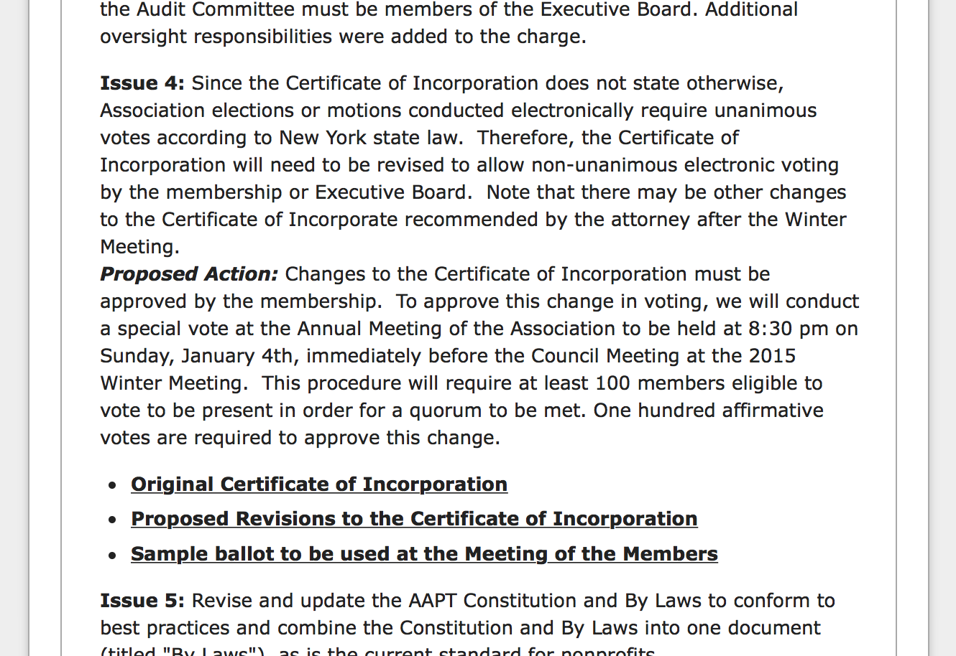
For more information

Slide 14
Formal Resolution and Vote
At Meeting of the Members - paper ballot
(sample ballot available at http://www.aapt.org/aboutaapt/organization/AAPT-Governance-Changes-2014.cfm)
Notes:
Steve should read it???

Slide 15
Meeting of the Members
When: Sunday, January 4th, at 8:30 pm, immediately following the plenary and prior to the Council meeting
Where: Grande Ballroom C (Marina Tower)
Please bring one or more friends (voting members of AAPT)!

Slide 16
Issue 5: Revise and Update Constitution & Bylaws
Revise and update the AAPT Constitution and Bylaws to conform to best practices
Combine the Constitution and By Laws into one document (titled "By Laws"), as is the current standard for nonprofits
Proposed Action: Bring the proposed changes to the Executive Board for approval no later than Summer 2015 and to the membership for approval in Fall 2015 as part of the general election

Slide 17
Issue 6: Powers To Go To Executive Board
Currently Council's power to
  resolve a tie in an election and
  to remove an elected member of the Executive Board
NY law states only the Executive Board may have these powers.
Proposed Action: Revise the Council portion of the AAPT Constitution (as part of revision of Constitution & Bylaws)

Slide 18
Issue 7: Sections
Redefine or revise the portion of the Constitution that deals with Sections.
One issue to resolve is that non-AAPT national members may elect Section Representatives.
Proposed Action: A subcommittee of Section Representatives is currently discussing possible revisions. Feedback needed from this group!

Slide 19
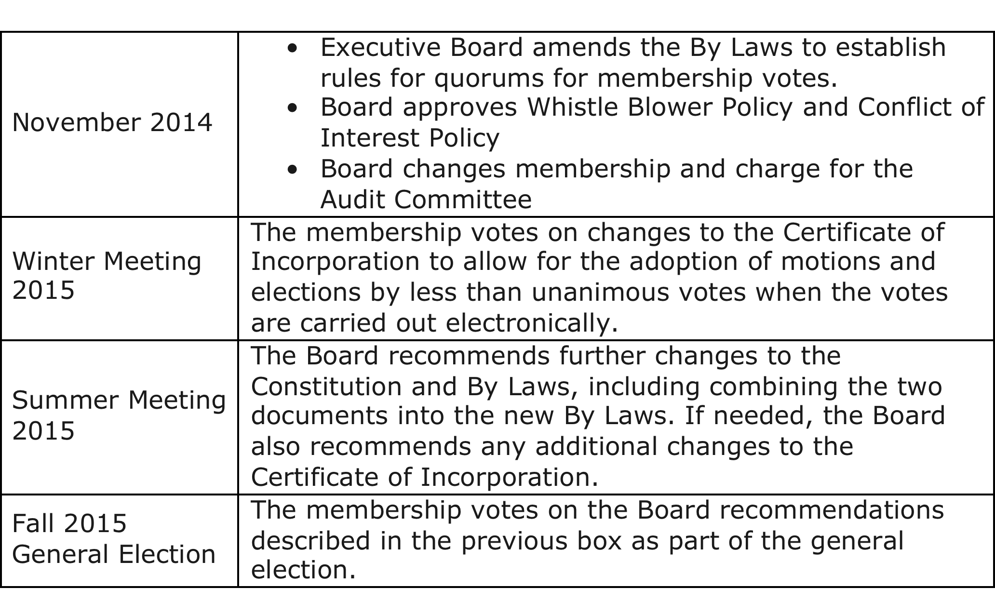
Recap

Slide 20
Questions?

